Slide 1
Introduction to junit
Issuer: [Mattias Kettil] [MKETTIL], [Volvo Car Corporation], [Introduction to JUnit.ppt], Security Class: Proprietary

Slide 2
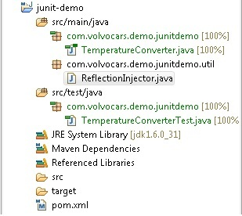
Maven project structure
Tip: MoreUnit (built-in in Java Dev Tools) gives us the command
Ctrl+J, that toggles between test class and regular class

Slide 3
Annotations
@Test
This method is a test.
@Before
Will be run before each test
@After
Will be run after each test
@BeforeClass
Static method that is run once before the first test in the class
@AfterClass
Static method that is run once after the last test in the class

Slide 4
What should I test?
Each test should test one thing only
Think functionality, not coverage
Avoid testing side effects (logging etc)
Do not test dependencies

Slide 5
Asserts
Common assert methods from org.junit.Assert:
assertTrue(expr)/assertFalse(expr)
Examples: assertTrue(Util.isEmpty(””));
assertFalse(Util.isNegative(12));
assertEquals(expected, actual)
Examples: assertEquals(“A”, Util.toUpper(“a”));
assertEquals(12, Util.multiply(3, 4));

Slide 6
Handling exceptions
Never use try-catch in JUnit tests, just use a throws clause.
For expected exceptions, use @Test(expected=<class>)
Example:@Test(expected=NullPointerException.class)

Slide 7
Naming the Unit Tests
The name of the test should describe exactly what the test is doing.
@Test(expected=ArrayIndexOutOfBoundsException.class)
public void getThrowsArrayIndexOutOfBoundsExceptionForNegativeValues() {
myArrayList.get(-1);
}

Slide 8
Mocking (one interpretation)
A Mock class is a replacement class for a dependency that you don’t want to test.
Usually named <originalClass>Mock.java
Extends the original class (or implements the interface)
Often has additional helper methods to set outdata or retrieve passed arguments.

